Slide 1




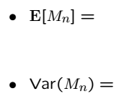
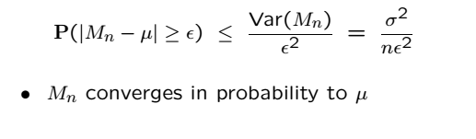
Weak Law of Large Numbers
aka convergence of the sample mean in probability
are i.i.d. with finite mean and variance

Slide 2
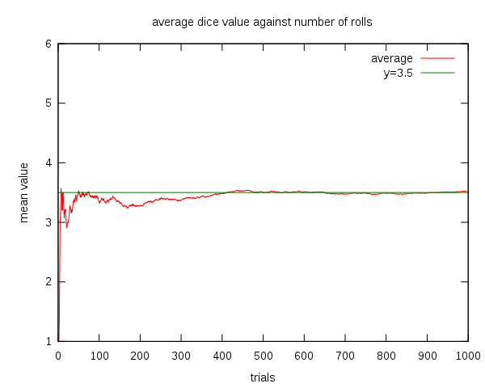
WLLN Picture
Average of a roll of a single dice (from wikipedia)

Slide 3
WLLN Remarks
LLN can be misunderstood and lead to “gambler’s fallacy”
There is also SLLN, which involves another type of convergence
We will not distinguish these, see a more advanced course
There are different LLN depending on defn of convergence
The independence assumption can be relaxed, but not too much
Extreme case where LLN fails: All RVs are the same
Dependent case where LLN doesn’t fail depends on covariances
(see next slide)

Slide 4
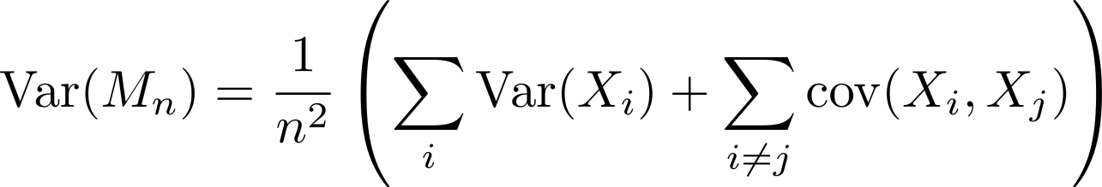

WLLN Holds under Some Dependence
If the variance goes to zero, we are done by Chevbychev
Consider a moving average example below
Gaussians are independent with zero mean and variance

Slide 7
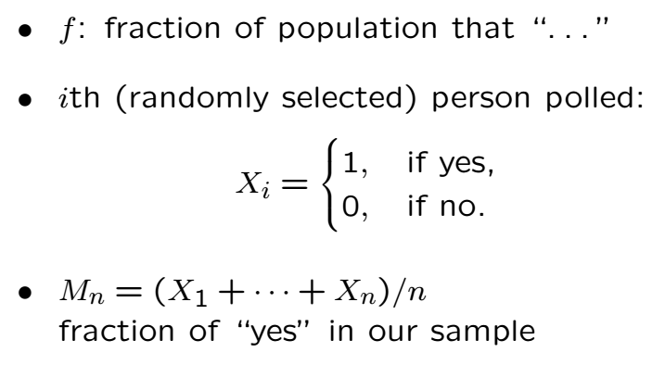
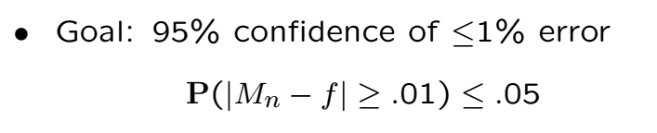
Q: How many people should we poll

Slide 8
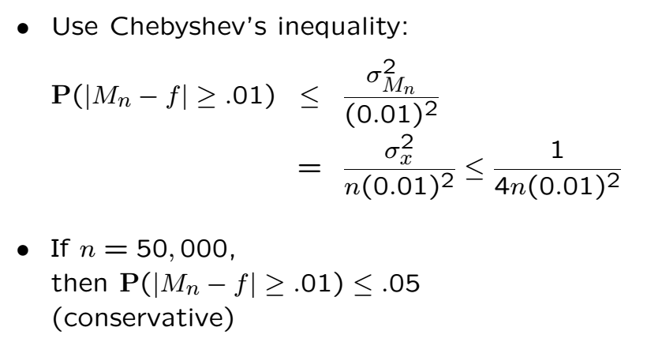
Polling Cont’

Slide 9
Acknowledgements and Citations
Parts of these slides are adapted from the following resources:
Power Point Lecture Slides for the Textbook http://bcs.wiley.com/hebcs/Books?action=index&bcsId=8676&itemId=1118324560
John Tsitsiklis. 6.041 Probabilistic Systems Analysis and Applied Probability, Fall 2010. (Massachusetts Institute of Technology: MIT OpenCourseWare),http://ocw.mit.edu (Accessed 13 Apr, 2015). License: Creative Commons BY-NC-SA

